Slide 1
Online Teaching Portfolio
Kylene Cooley
A statement of teaching philosophy and samples of course materials
Note: Audio transcripts are included in the presentation notes.

Slide 2

Hello, and welcome to my online teaching portfolio.
Click here to restart the narration!
Selection of works contained here:
Activities
Assessments
Principles
Plan for a course to teach LaTeX
A free typesetting language
Notes:
Audio Transcript:
Hello, and welcome to my online teaching portfolio.
The works that are contained in this presentation demonstrate a selection of activities, assessments, and principles that I will use to teach an online class.
In this version specifically, you will find a plan for a course to teach graduate students in any field the basics and usefulness of LaTeX, a typesetting language that is available to use for free.

Slide 3
This course was born out of a conversation…
Problem: Writing a thesis in Microsoft Word and leaving the figure references blank until finished editing
Solution: LaTeX makes it easy and intuitive to include cross-references.
What I think often bars people from learning coding-adjacent skills:
Steep learning curve
Lack time to dive in alone
Click here to restart the narration!
Notes:
Audio Transcript:
The idea for this course was born out of a conversation…
I was having with a friend where she was writing her thesis in Microsoft Word and leaving the figure references blank until they were done editing.
Her advisor recommended this method, and it was the best way she knew of.
I then shared my own experiences using LaTeX to write my thesis while making it easy and intuitive to include cross-references.
This friend brought up a good point after expressing how she would like to learn to use LaTeX eventually.
I think this often bars people from learning coding-adjacent skills:
Learning how to type in another “language”, especially on your own, has a steep learning curve and there isn’t always time for that in an undergraduate or graduate program.

Slide 4
LaTeX for Any Discipline
Click here to restart the narration!
Who is it for?
Anyone writing scholarly or independent works
Often references figures, cites sources, and types math or tables
How does it work?
Demonstrating tools
Encourage progress in thesis research and writing
Backwards design model
Student feedback determines exact topic order
Notes:
Audio Transcript:
This is why I developed LaTeX for Any Discipline, so that anyone writing scholarly or independent works with specific needs such as referencing figures, citing sources, and typesetting math or tables could do so with the tools designed to make this easier.
While demonstrating to participants how to take advantage of these tools, I anticipate that this course will encourage progress in research and writing for the thesis.
With this goal in mind, I used a backwards design model to write assessments.
The activities and topic order are steered by feedback from students.

Slide 5

Course Syllabus Content
Click here to restart the narration!
How the online classroom will function
Content of the course
Skill sets developed
Communication/participation expectations
Course plan is fluid up through first module
Could be accelerated or abbreviated
Click to view the PDF linked above
Notes:
Audio Transcript:
Embedded in this slide is a draft of a syllabus that describes how the online classroom will function and what to expect in terms of content of the course, skills sets developed, and communication or participation expectations.
Currently there is no schedule included because the course plan is fluid up through the first module or the first document assignment where students provide feedback with goals.
The total content included would depend on the length of the term or session. For example, the course could be trimmed down to fit in an accelerated summer term, around 5 to 6 weeks long.

Slide 6

Summative Assessment – Final Project
Click here to restart the narration!
Create an original document
Synthesizing knowledge of the tools taught
Demonstrate use of one of the following special document features:
A figure
Inline or display math
Block quote
A table
Click to view the PDF linked above
Notes:
Audio Transcript:
Within the syllabus, I mentioned a final project.
The summative assessment for this course is an original document that students must create by synthesizing knowledge of the tools taught in this course.
The document can be a thesis draft, report, literature review, or original creative work depending on the student’s goal.
Ability to use LaTeX is assessed through some formatting requirements that will be the same for all students and a choice of at least one specific document element from a figure, math, a block quote, or a table.

Slide 7
Class Introductions Activity
Click here to restart the narration!
First active learning activity
Editing the LaTeX source code of a template
Students have the opportunity to introduce themselves
Fosters student-to-student interaction through a discussion forum
Five-minute video assignment introduction
Click to view the PDF linked above
Notes:
Audio Transcript:
The first learning activity for the course guides students through editing the source code of a template to create their first document in LaTeX.
They will introduce themselves to their peers and learn about others in the course by posting these documents to a discussion forum and replying to two peers.
This assignment and useful editing features of Overleaf are introduced in the following five-minute video.

Slide 8
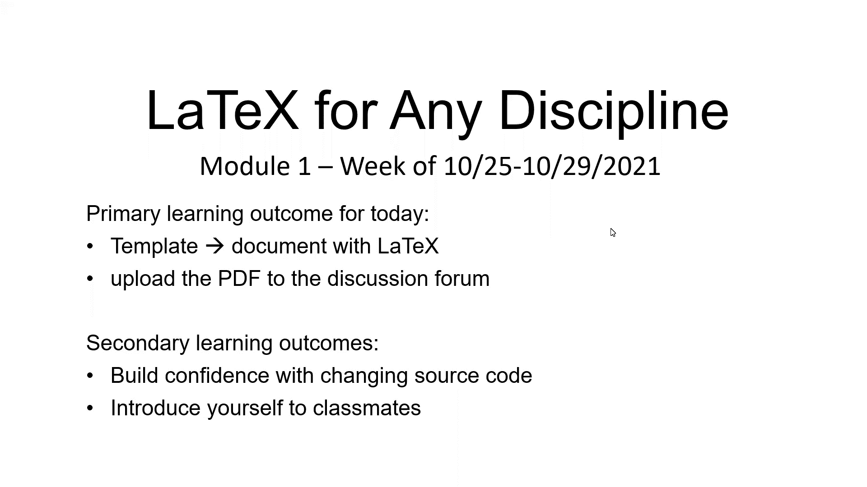
Notes:
No audio on slide, video has audio and captions.

Slide 9
WikiBook Roulette Activity
Click here to restart the narration!
Prioritizes the material according to class interests
Quickly cover a large amount of material
Students will compile a subset of commands to create personally relevant documents
Click to view the PDF linked above
Notes:
Audio Transcript:
The activity embedded here will be used after the introductory module to prioritize the material according to class interests.
It allows a large amount of material to be covered quickly since the students are each summarizing a unique topic for their peers to refer to as needed.
By the end of this activity, they will have a subset of the most useful commands in the discussion forum for quick reference.
Students will learn how to use a comprehensive resource to create document features that are personally relevant without the need to individually read the entire online book.

Slide 10
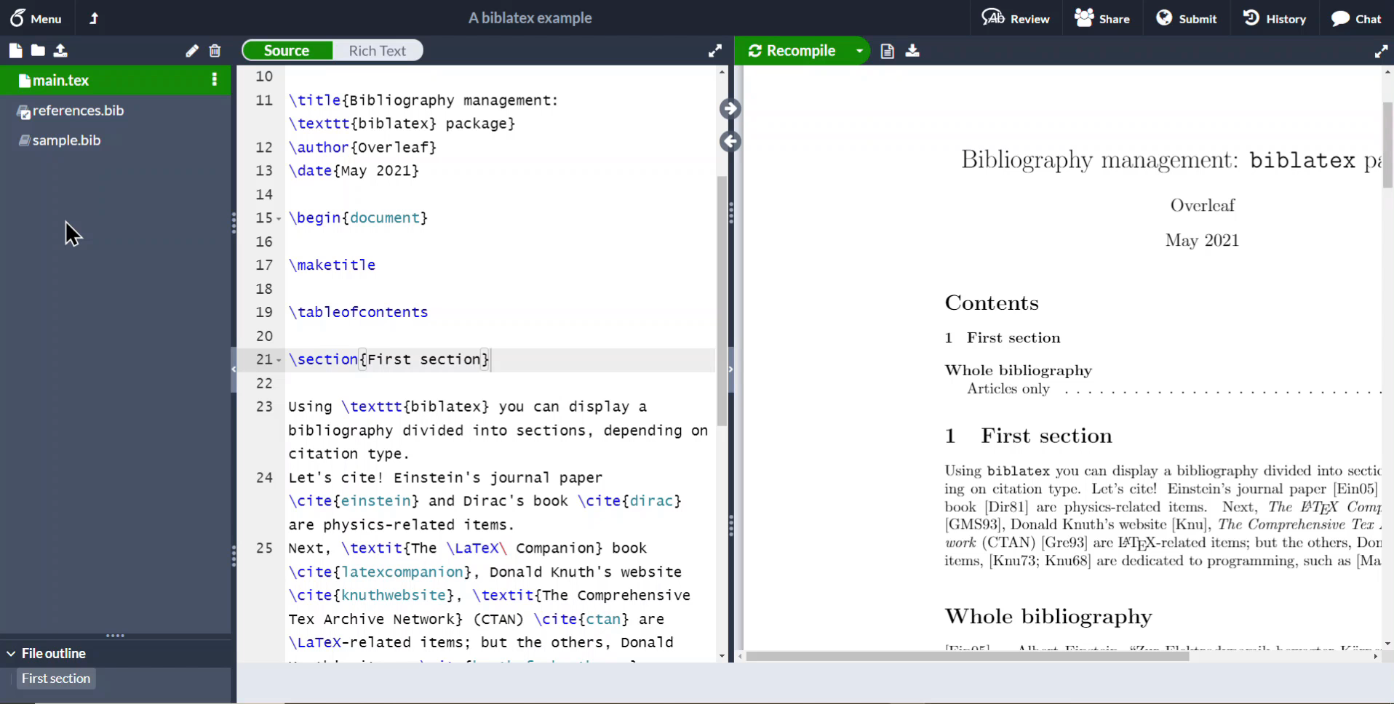
Streamlining reproducible research
Click here to restart the narration!
Integrating references from Mendeley or Zotero with the Overleaf documentation page
Additional source of answers to common issues
Generates shortened names for reference
Using Zotero, (n.d.).
Notes:
Audio Transcript:
Students will also learn how to streamline the process of research and writing a credible story in literature reviews or background by integrating references through Mendeley or Zotero.
The lesson materials come from existing tutorials on the Overleaf documentation page
This is an opportunity to introduce an additional source of answers to common issues for students to use
Importing references from a reference manager outsources extra effort spent managing and adding sources to the BibTeX file and saves time on remembering a naming scheme for sources.
If the student has to invent one, they may decide to change it in the middle of the project after some practice and create more work for themselves.
Click on the video to watch a demonstration of using Zotero from the documentation page.
Video has no audio.

Slide 11
Sources
Using Zotero [Video]. (n.d.). Overleaf. Retrieved November 26, 2021, from https://www.overleaf.com/learn/how-to/How_to_link_your_Overleaf_account_to_Mendeley_and_Zotero.

